Slide 1
Compiler Construction
Teacher : Zulfiqar Ali
Email: Zulfiqar.rafique@nu.edu.pk
Office: No.6,Basement -1 (CS Block 1)

Slide 2
Week 5:
Left Recursion
Left Factoring
Grammar Rules
First()
Follow()
Nullable
Right Recursion
Predictive Parser

Slide 3
Left Recursion Grammar
A production of grammar is said to have left recursion if the leftmost variable of its RHS is same as variable of its LHS.
A grammar containing a production having left recursion is called as Left Recursive Grammar.
Example: S → Sa / ∈

Slide 4
Types of Left Recursion
Direct Left recursion
B->Ba
Indirect Left Recursion
S->Aa
A->Sm

Slide 5
Why Eliminate Left Recursion
Some Top-Down Parsers cannot accept the Grammar having left Recursion.
If a left recursion is present in any grammar then, during parsing in the syntax analysis part of compilation, there is a chance that the grammar will create an infinite loop. This is because, at every time of production of grammar, S will produce another S without checking any condition.

Slide 6
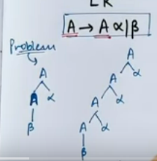
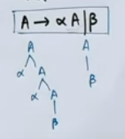
Why Eliminate Left Recursion
β α* α* β

Slide 7
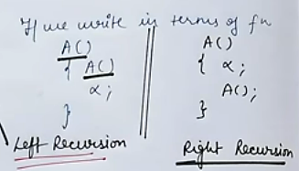

Slide 8
Eliminating Left Recursion
Left recursion is eliminated by converting the grammar into a right recursive grammar.
If we have the left-recursive pair of productions- A → Aα | β where β does not begin with an A.
Then, we can eliminate left recursion by replacing the pair of productions with-
A → βA’
A’ → αA’ | ∈
This right recursive grammar functions same as left recursive grammar.

Slide 9
Algorithm to Remove Left Recursion
Suppose we have a grammar which contains left recursion: S ⇒ S a | S b | c | d
Introduce a new nonterminal and write it at the end of every terminal. We create a new nonterminal S’ and write the new production as: S ⇒ cS' | dS'
Write the newly produced nonterminal S’ in the LHS, and in the RHS it can either produce S’ or it can produce new production in which the terminals or non terminals which followed the previous LHS will be replaced by the new nonterminal S’ at the end of the term. S' ⇒ ε | aS' | bS‘

Slide 10
So, after conversion, the new equivalent production is: S ⇒ cS' | dS' S' ⇒ ε | aS' | bS'

Slide 11
Eliminate Left Recursion Examples
Consider the following grammar and eliminate left recursion-
A → ABd / Aa / a
B → Be / b
Solution:
The grammar after eliminating left recursion is-
A → aA’
A’ → BdA’ / aA’ / ∈
B → bB’
B’ → eB’ / ∈

Slide 12
Eliminate Left Recursion Examples
Consider the following grammar and eliminate left recursion-
S → (L) / a
L → L , S / S
Solution-
The grammar after eliminating left recursion is-
S → (L) / a
L → SL’
L’ → ,SL’ / ∈

Slide 13
Eliminate Left Recursion Examples
Consider the following grammar and eliminate left recursion-
E → E + T / T
T → T x F / F
F → id
Solution-
The grammar after eliminating left recursion is-
E → TE’
E’ → +TE’ / ∈
T → FT’
T’ → xFT’ / ∈
F → id

Slide 14
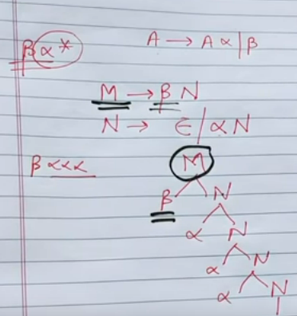
Tree after Eliminating Left Recursion
E

Slide 15
Removing Indirect Left Recursion in a Grammar
A grammar is said to have indirect left recursion if, starting from any symbol of the grammar, it is possible to derive a string whose head is that symbol. For example.
A ⇒ B r
B ⇒ C d
C ⇒ A t

Slide 16
Algorithm to Remove Indirect Recursion with help of an example:
A1 ⇒ A2 A3
A2 ⇒ A3 A1 | b
A3 ⇒ A1 A1 | a
Identify the productions which can cause indirect left recursion. In our case.
A3 ⇒ A1 A1 | a
Substitute its production at the place the terminal is present in any other production: substitute A1–> A2 A3 in production of A3.
A3 ⇒ A2 A3 A1 | a

Slide 17
Now in this production substitute A2 ⇒ A3 A1 | b
A3 ⇒ (A3 A1 | b) A3 A1 | a
A3 ⇒ A3 A1 A3 A1 | b A3 A1 | a
Now the new production is converted in the form of direct left recursion, solve this by the direct left recursion method.
A3 ⇒ b A3 A1 A' | aA'
A' ⇒ ε | A1 A3 A1 A'
The resulting grammar is then:
A1 ⇒ A2 A3
A2 ⇒ A3 A1 | b
A3 ⇒ b A3 A1 A' | aA'
A' ⇒ ε | A1 A3 A1 A'

Slide 18
Example
A → Ba / Aa / c
B → Bb / Ab / d
Step-01: First let us eliminate left recursion from A → Ba / Aa / c
Eliminating left recursion from here, we get-
A → BaA’ / cA’
A’ → aA’ / ∈
Now, given grammar becomes-
A → BaA’ / cA’
A’ → aA’ / ∈
B → Bb / Ab / d
Step-02: Substituting the productions of A in B → Ab, we get the following grammar-
A → BaA’ / cA’
A’ → aA’ / ∈
B → Bb / BaA’b / cA’b / d

Slide 19
Step-03:
Now, eliminating left recursion from the productions of B, we get the following grammar.
A → BaA’ / cA’
A’ → aA’ / ∈
B → cA’bB’ / dB’
B’ → bB’ / aA’bB’ / ∈

Slide 20
Grammar With Common Prefixes-
If RHS of more than one production starts with the same symbol, then such a grammar is called as Grammar With Common Prefixes.
Example:
A → αβ₁ / αβ₂ / αβ₃

Slide 21
Left Factoring Elimination
Left factoring is a grammar transformation that is useful for producing a grammar suitable for predictive or top-down parsing.
Consider following grammar:
Stmt -> if expr then stmt else stmt
| if expr then stmt
On seeing input if it is not clear for the parser which production to use

Slide 22
Left Factoring Elimination
We can easily perform left factoring:
If we have A->αβ1 | αβ2 then we replace it with
A -> αA’
A’ -> β1 | β2

Slide 23
Left Factoring Elimination Examples
Grammar A → aAB / aBc / aAc
Solution
A → aA’
A’ → AB / Bc / Ac
Again, this is a grammar with common prefixes.
A → aA’
A’ → AD / Bc
D → B / c

Slide 24
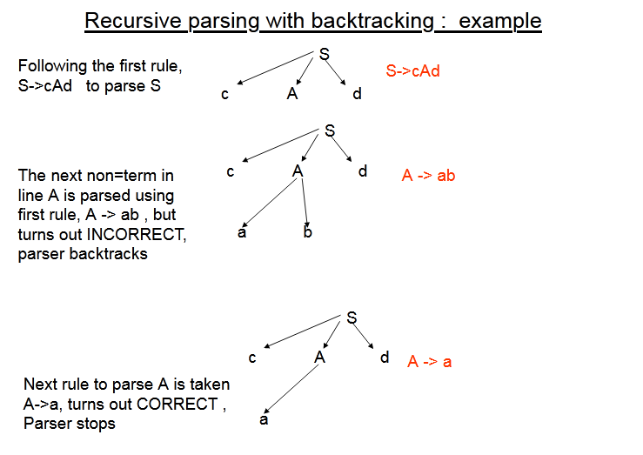
S-> cAd
A-> ab | a

Slide 25
Why First
If the compiler would have come to know in advance, that what is the “first character of the string produced when a production rule is applied”, and comparing it to the current character or token in the input string it sees, it can wisely take decision on which production rule to apply.
Let’s take a grammar
S -> cAd
A -> bc|a
the input string is “cad”.

Slide 26
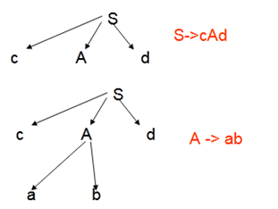
In the example above, if it knew that after reading character ‘c’ in the input string and applying S->cAd.
Next character in the input string is ‘a’, then it would have ignored the production rule A->bc (because ‘b’ is the first character of the string produced by this production rule, not ‘a’ ), and directly use the production rule A->a.
(because ‘a’ is the first character of the string produced by this production rule, and is same as the current character of the input string which is also ‘a’).
Hence it is validated that if the compiler/parser knows about first character of the string that can be obtained by applying a production rule, then it can wisely apply the correct production rule to get the correct syntax tree for the given input string.

Slide 27
Why Follow
The parser faces one more problem. Let us consider below grammar to understand this problem.
A -> aBb
B -> c | ε
And suppose the input string is “ab” to parse.

Slide 28

As the first character in the input is a, the parser applies the rule A->aBb.
Now the parser checks for the second character of the input string which is b, and the Non-Terminal to derive is B, but the parser can’t get any string derivable from B that contains b as first character.

Slide 29
But the Grammar does contain a production rule B -> ε, if that is applied then B will vanish, and the parser gets the input “ab”, as shown below. But the parser can apply it only when it knows that the character that follows B in the production rule is same as the current character in the input.

Slide 30
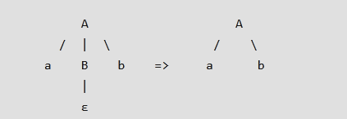
In RHS of A -> aBb, b follows Non-Terminal B, i.e. FOLLOW(B) = {b}, and the current input character read is also b. Hence the parser applies this rule. And it is able to get the string “ab” from the given grammar.

Slide 31
First()
First(α) is a set of terminal symbols that begin in strings derived from α.
Example:Consider the production rule- A → abc / def / ghi
Then, we have-
First(A) = { a , d , g }

Slide 32
Rules to find First()
For a production rule X → ∈,
First(X) = { ∈ }
For any terminal symbol ‘a’, X → a
First(a) = { a }

Slide 33
Rules to find First()
For a production rule X → Y1Y2Y3
Calculating First(X)
If ∈ ∉ First(Y1), then First(X) = First(Y1)
If ∈ ∈ First(Y1), then First(X) = { First(Y1) – ∈ } ∪ First(Y2Y3)
Calculating First(Y2Y3)
If ∈ ∉ First(Y2), then First(Y2Y3) = First(Y2)
If ∈ ∈ First(Y2), then First(Y2Y3) = { First(Y2) – ∈ } ∪ First(Y3)

Slide 34
Rules to Find Follow()
For the start symbol S, place $ in Follow(S).
For any production rule A → αB
Follow(B) = Follow(A)
For any production rule A → αBβ,
If ∈ ∉ First(β), then Follow(B) = First(β)
If ∈ ∈ First(β), then Follow(B) = { First(β) – ∈ } ∪ Follow(A)

Slide 35
Important Notes
∈ may appear in the first function of a non-terminal.
∈ will never appear in the follow function of a non-terminal.
Before calculating the first and follow functions, eliminate Left Recursion from the grammar, if present.
We calculate the follow function of a non-terminal by looking where it is present on the RHS of a production rule.

Slide 36
Examples:
Calculate the first and follow functions for the given grammar-
Finding First
First(S) = First(A) = { a }
First(A) = { a }
First(A’) = { d , ∈ }
First(B) = { b }
First(C) = { g }
S → A
A → aBA’
A’ → dA’ / ∈
B → b
C → g

Slide 37
Examples
S → A
A → aBA’
A’ → dA’ / ∈
B → b
C → g
Finding Follow
Follow(S) = { $ }
Follow(A) = Follow(S) = { $ }
Follow(A’) = Follow(A) = { $ }
Follow(B) = { First(A’) – ∈ } ∪ Follow(A) = { d , $ }
Follow(C) = NA

Slide 38
First and Follow
First () | Follow()
First(S) = First(A) = { a } | Follow(S) = { $ }
First(A) = { a } | Follow(A) = Follow(S) = { $ }
First(A’) = { d , ∈ } | Follow(A’) = Follow(A) = { $ }
First(B) = { b } | Follow(B) = { First(A’) – ∈ } ∪ Follow(A) = { d , $ }
First(C) = { g } | Follow(C) = NA

Slide 39
Example
Calculate the first and follow functions for the given grammar-
E → TE’
E’ → + TE’ / ∈
T → FT’
T’ → x FT’ / ∈
F → (E) / id

Slide 40
First
First(E) = First(T) = First(F) = { ( , id }
First(E’) = { + , ∈ }
First(T) = First(F) = { ( , id }
First(T’) = { x , ∈ }
First(F) = { ( , id }
E → TE’
E’ → + TE’ / ∈
T → FT’
T’ → x FT’ / ∈
F → (E) / id

Slide 41
Follow
Follow(E) = { $ , ) }
Follow(E’) = Follow(E) = { $ , ) }
Follow(T) = { First(E’) – ∈ } ∪ Follow(E) ∪ Follow(E’) = { + , $ , ) }
Follow(T’) = Follow(T) = { + , $ , ) }
Follow(F) = { First(T’) – ∈ } ∪ Follow(T) ∪ Follow(T’) = { x , + , $ , ) }
E → TE’
E’ → + TE’ / ∈
T → FT’
T’ → x FT’ / ∈
F → (E) / id

Slide 42
Example 2
Calculate the first and follow functions for the given grammar-
Finding First
First(S)={(, a}
First(L)={(, a}
First (L’)={, , ∈}
S → (L) / a
L → SL’
L’ → ,SL’ / ∈

Slide 43
Example 2
Calculate the first and follow functions for the given grammar-
Finding Follow
Follow(S)={ $ , , , ) }
Follow(L) = { ) }
Follow(L’) = Follow(L) = { ) }
S → (L) / a
L → SL’
L’ → ,SL’ / ∈

Slide 44
Reference:
Compilers: Principles, Techniques, and Tools 2nd Edition by Alfred Aho , Jeffrey Ullman, Ravi Sethi, Monica Lam
Introduction to Compilers and Language Design | Second Edition | Prof. Douglas Thain - University of Notre Dame

